Slide 1

DriverPass System Analysis
Darrell Walker
Notes:
[No speaker notes required for this slide.]

Slide 2

System Requirements
Functional Requirements:
Customer Lesson Management:
Admin Control
Nonfunctional Requirements:
Security
Scalability
Notes:
Functional Requirements:
Customer Lesson Management: Customers must be able to book, modify, and cancel driving lessons online.
Admin Control: Admins should have the ability to manage lesson schedules, customer accounts, and view reports.
Nonfunctional Requirements:
Security: The system must ensure customer data, including personal and payment details, is protected through encryption and secure authentication.
Scalability: The system should be able to handle growth in the number of users and lessons, ensuring performance is not affected as the business expands.
The functional requirements, such as customer lesson management and admin control, ensure that DriverPass provides a user-friendly system where customers can easily schedule or modify lessons, and admins can efficiently manage operations. The nonfunctional requirements, including security and scalability, protect sensitive data and allow the system to grow with the company. Together, these features meet DriverPass's need for a secure, flexible, and reliable system that supports their long-term business goals.

Slide 3
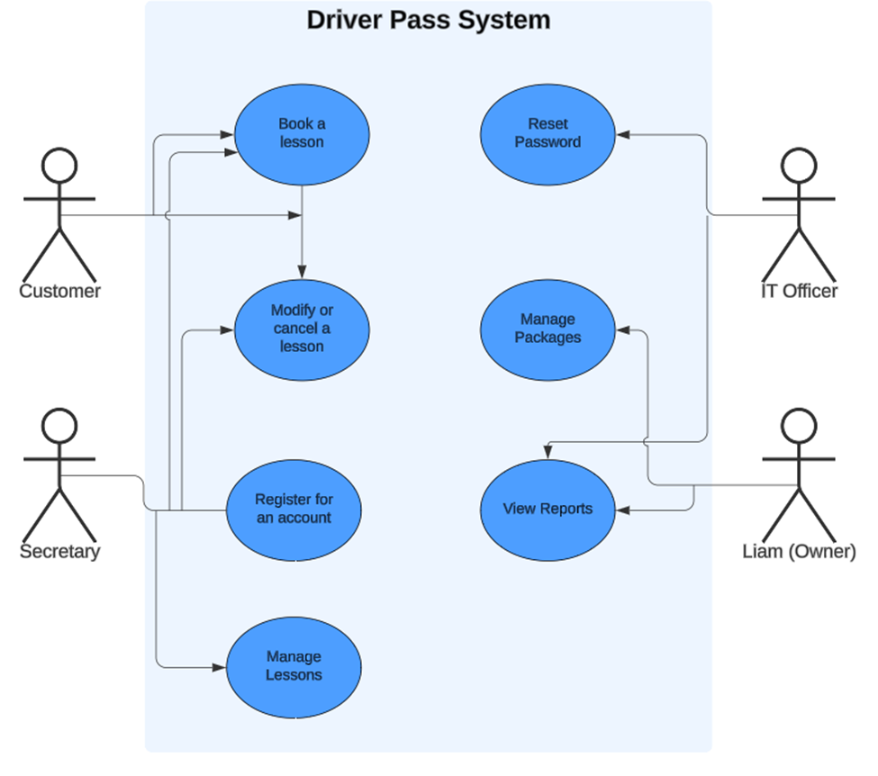
Use Case Diagram
Notes:
In the DriverPass system, different users interact with the system to perform various tasks. Customers can book or modify driving lessons and create an account. Secretaries manage lesson schedules for customers. IT Officers handle password resets and ensure smooth system operations. Liam, the owner, manages driving packages and views business reports to monitor progress. This design meets DriverPass’s needs by providing convenient access for customers to manage their lessons and allowing employees to maintain control over administrative tasks and system functionality.

Slide 4
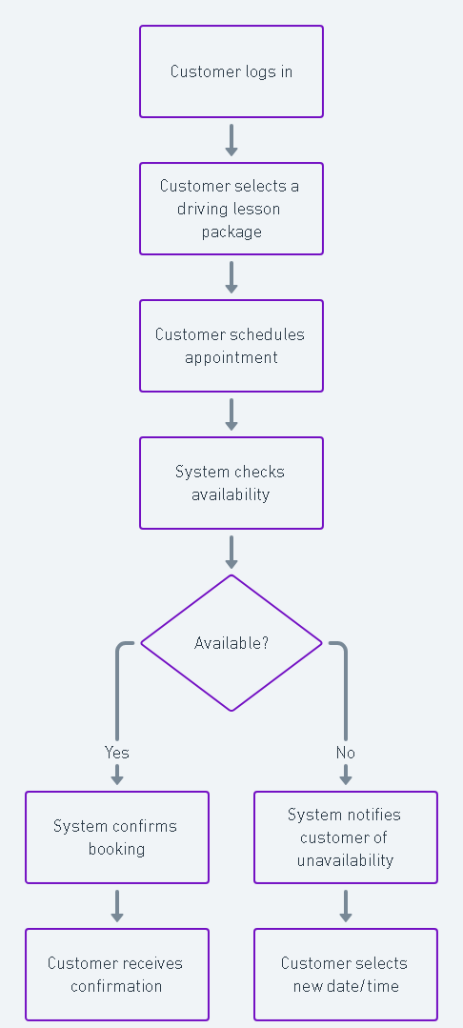
Activity Diagram
Notes:
The activity diagram breaks down the process for scheduling a driving lesson in the DriverPass system. The customer begins by logging into their account, then selects a driving lesson package and schedules an appointment. The system checks if the selected date and time are available. If the slot is available, the system confirms the booking and sends a confirmation to the customer. If the slot is unavailable, the system notifies the customer, who can then choose a new date or time. This design ensures that the lesson scheduling process is smooth and efficient, meeting DriverPass’s need for an easy-to-use system.

Slide 5
Security
Addressing Security Concerns:
Encryption
Role-Based Access Control
Secure Authentication
Session Management
Data Backup
Notes:
Encryption: All sensitive data, including customer information and payment details, will be encrypted to prevent unauthorized access.
Role-Based Access Control: Different user roles (e.g., customer, IT officer, admin) will have varying access levels, ensuring only authorized personnel can modify critical system data.
Secure Authentication: The system will require strong passwords and provide secure password reset functionality to ensure user account security.
Session Management: The system will automatically log out inactive users to prevent unauthorized access to open sessions.
Data Backup: Regular backups will ensure that customer data is protected and can be restored in case of system failure or data corruption.
These measures ensure that the system remains secure, protecting both customer data and the integrity of the DriverPass system.
When designing the DriverPass system, we focused on protecting customer information and ensuring only authorized users can access sensitive data. For example, we included secure login features that require strong passwords, and the system automatically logs users out after a period of inactivity to prevent unauthorized access. We also limited what each user can do in the system, meaning only certain employees can manage lesson schedules or reset passwords. Lastly, we regularly back up all customer data so nothing is lost in case of a technical issue. These security measures help keep the system safe for both customers and staff.

Slide 6
System Limitations
limitations of the system:
Internet Dependence
Manual Package Updates
Scalability Constraints
Limited Offline Access
Notes:
Internet Dependence: Users need an internet connection to book or modify lessons, which may limit access in areas with poor connectivity.
Manual Package Updates: While the system allows for managing driving lesson packages, adding or removing packages requires developer support, which may delay changes.
Scalability Constraints: The system is designed to handle growth, but significant expansion might require additional infrastructure upgrades to maintain performance.
Limited Offline Access: The system doesn't offer full offline functionality, meaning users must be online to interact with their accounts or book lessons.
These limitations reflect areas where the system could be improved in future updates.
Conclusion:
In conclusion, the DriverPass system has been carefully designed to meet the needs of both customers and staff. It provides a user-friendly way for customers to schedule and manage driving lessons while giving the DriverPass team full control over lesson management, reporting, and system security. While there are some limitations, such as the need for internet access and manual updates for driving packages, these areas can be improved in future iterations. Overall, this system ensures flexibility, scalability, and security, supporting DriverPass’s goal to offer a seamless, reliable, and accessible driving lesson experience for all users.

